Slide 1
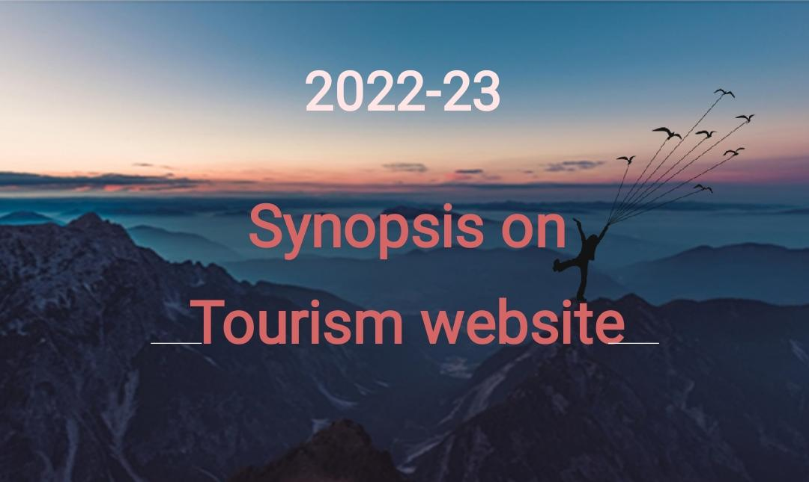

Slide 2
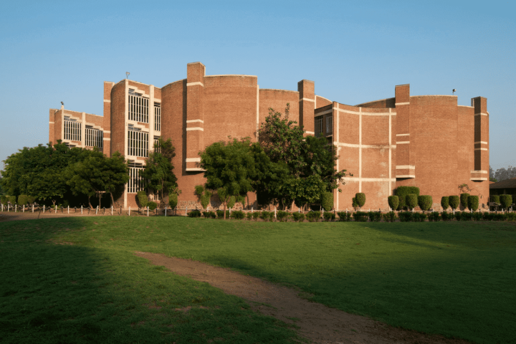
Submitted to :
Ajay kumar garg engineering college
Prepared by:
Vikash
Sagar
Shivam
Mahendra
Guide by: M.r Ashish kumar

Slide 3
TABLE OF CONTENTS
°Objective
°About the website
°Website image
°Technologies
°Design
°Conclusion
°Reference

Slide 4

To provide entertainment to tourists, organise tourism related activities such as cultural shows, fairs and festivals etc. To take over and develop and manage places of tourist interest, parks, lakes, avenues, beaches and recreational places, spots etc.

Slide 5
ABOUT THE PROJECT
This project is based on how an effective travel website will make us feel. It is based on a traveling website with fully-featured functions that will activate the traveling bug with vibrant imagery. This website contains highlights of some important places along with high-quality photography and allows people to book their dream destination wit…

Slide 6
Website images

Slide 7
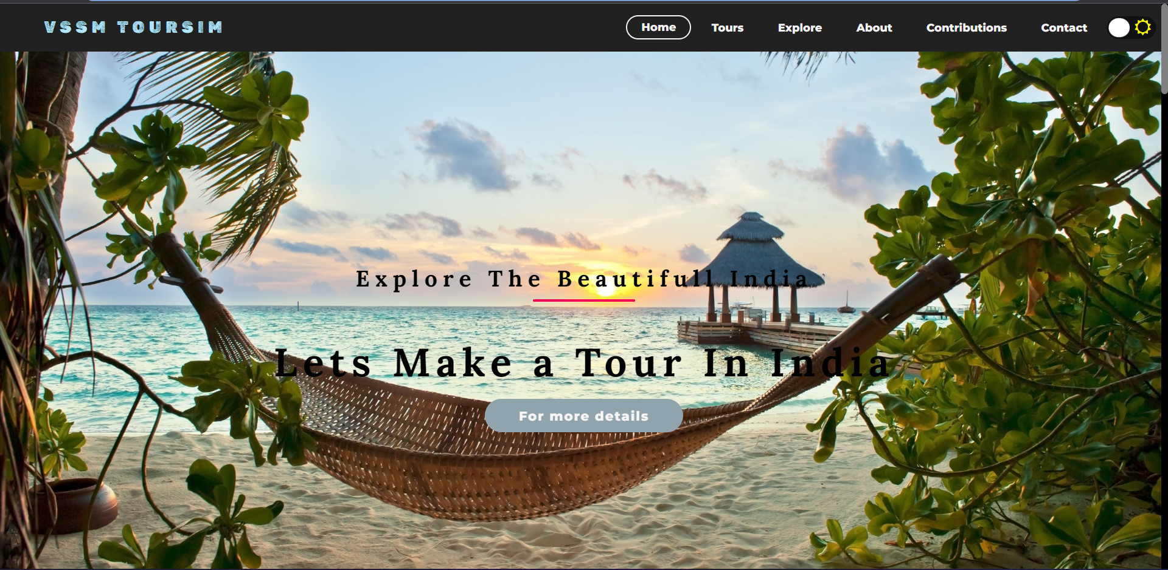

Slide 8
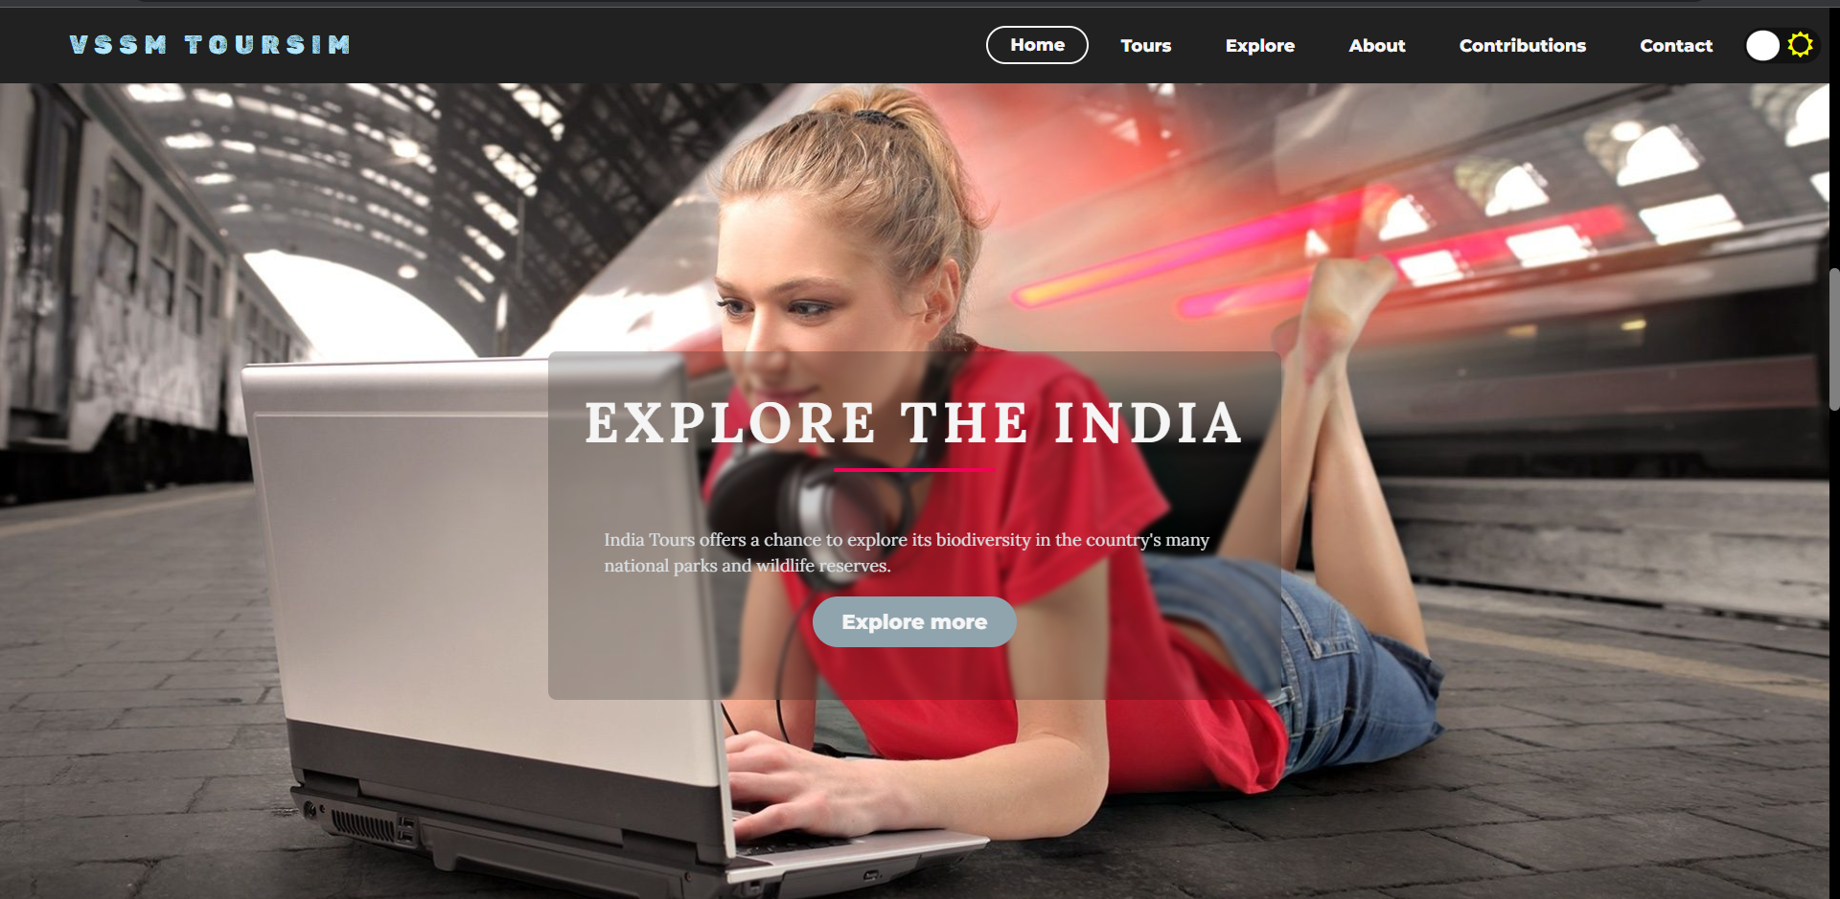

Slide 9
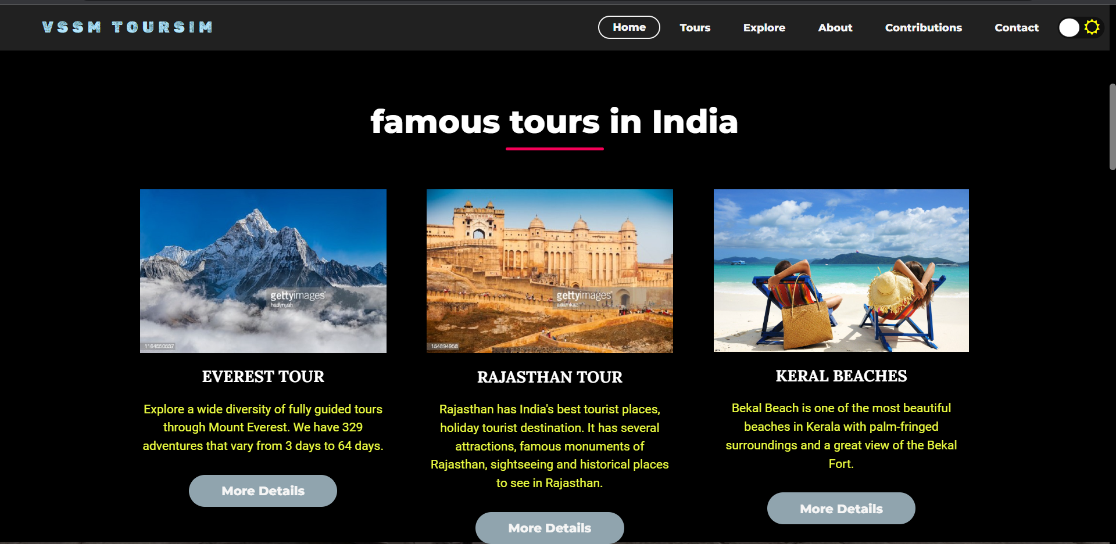

Slide 10
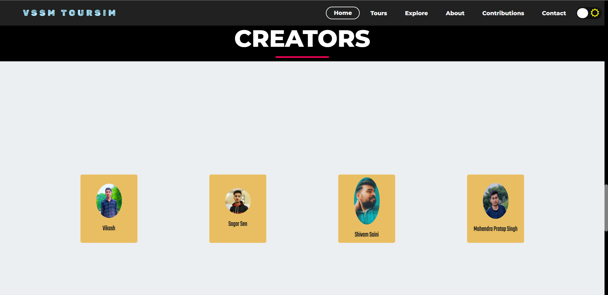

Slide 11
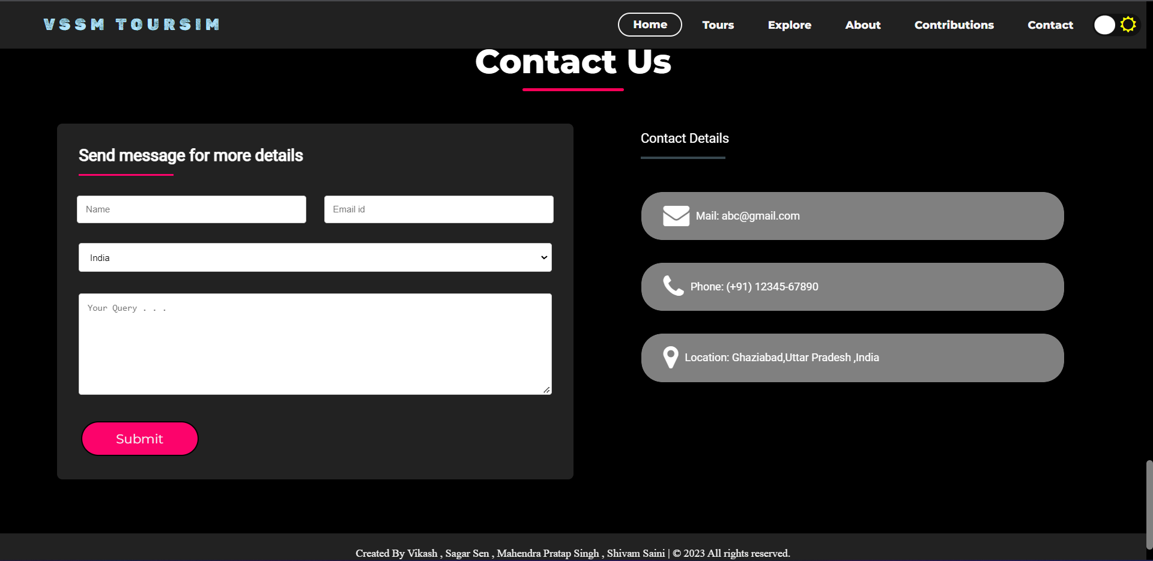

Slide 12



*Technology
°Html
°Css
°Java script

Slide 13
Design
Home page
About
Tour

Slide 14
Conclusion
In conclusion, we can say that tourism is a very productive activity both for the tourist and the government. As they support each other simultaneously.

Slide 15
References:
https://www.w3schools.com/
https://www.google.co.in/
https://html.com/
https://www.javascript.com/

Slide 16
THANKS!

